Slide 1

Stage 1 I Know the Ropes Course Designer: Ken Wang
I Know the Ropes is a 22 round, 110 point Comstock Long course. There are 10 USPSA targets and 2 steel targets. The best two hits per target will score. Steel must fall to score. The start signal is audible.
The handgun start position is hands both hands touching either mark. Handgun is loaded and holstered. PCC start position is stock on belt, safety on, muzzle touching either mark.
On the audible start signal, engage all targets from within the shooting area. Popper P1 activates swinger S1 and Popper P2 activates swinger S2. Both S1 and S2 are visible at rest.

Slide 2
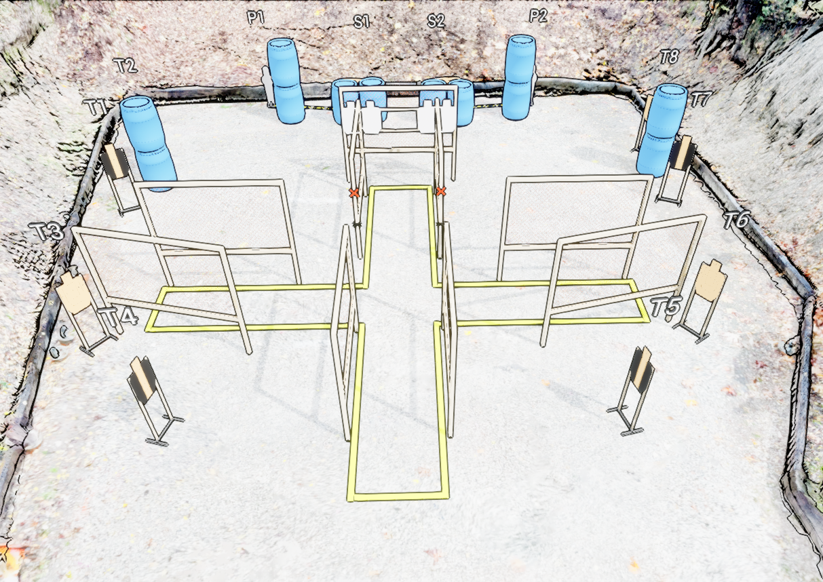
 | Stage 1 I Know the Ropes Course Designer: Ken Wang

